Slide 1
Maximum Sustainable Yield
After Caddy (1993) three distinct management strategies exist.
constant catch quotas to achieve TRPs
direct fishing effort control
constant escapement policy

Slide 2
Advantages and disadvantages
I.Constant catch quotas to achieve TRPs
less reliable due to the unrecorded catches and high discards
Based on TACs (Total Allowable Catches)
direct fishing effort control
increases in catch ability
technological improvements to boats and gear
constant escapement policy
compatible with spawning biomass RPs, but likely to require too high information input for the stock.

Slide 3
Targets and Limits
maintain a fishery close to a target reference points (TRPs) and limit reference points (LRPs) such as fmsy, Fmsy, Fmax, F_{0.1}.
During the last two decades the theory for LRPs and their use in fishery management has largely developed in response to criticism of MSY. The main one is that the MSY target provides an inadequate safety margin: if MSY is accidentally exceeded, recovery will not be rapid.

Slide 4
Fishery at MSY - exceeded an ecologically or economically optimal situation;
F-Fnow to be less than Fmsy (Normal or Log-normal distributions);
Objectives for utilization:
maximizing the volume of catch next year; maximizing the total export value of catch over ten years; or reducing the year-to-year variation in the supply of given species.

Slide 5
Objectives for sustainability might include maintaining a minimum stock size of adult fish; protecting juvenile fish in an area; or restricting the proportion of fish that can be caught each year
Among the quantities more precisely estimated are MSY, fmsy and relative biomass (B/Bmsy) and fishing mortality (F/Fmsy).
Two type of precautionary RPs, limits and targets and their management context are in Annex II of the UN Straddling Stocks Agreement (1995)

Slide 6
LRPs set boundaries which are intended to constrain harvesting within safe biological limits within which the stocks can produce MSY. Fishery management strategies shall ensure that the risk of exceeding LRPs is very low .If the stock falls bellow a LRP or is at risk of falling below such a RP, conservation and management action should be initiated to facilitate stock recovery.
Fishing mortality rate which generates MSY should be regarded as a minimum standard for LRPs .For stocks, which are not over fished, fishery management strategies, shall ensure that F does not exceed that which corresponds to MSY, and that the biomass does not fall below predefined thresholds.
LRPs should never be reached
The threshold RPs is defined as an “early warning” reference point, to reduce the probability that TRPs and LRPs would be exceeded due to estimation or observation uncertainty or due to slow management reaction. LRPs often called thresholds (Resterpo et al. 1998)

Slide 7
Mace (1994) for the objectives of management set two categories of risk:
- The risk of no achieving a TRP; and
- The risk of exceeding an LRP.
The risk of not achieving a TRP is usually defined in terms of the short-term reduction or interruption of the flow of benefits to fishery participants and consumers. The risk of exceeding an LRP range from stock decline to collapse, damage to associated species ecosystem destabilization, and long-term loss of earnings, including inter generational effects.

Slide 8
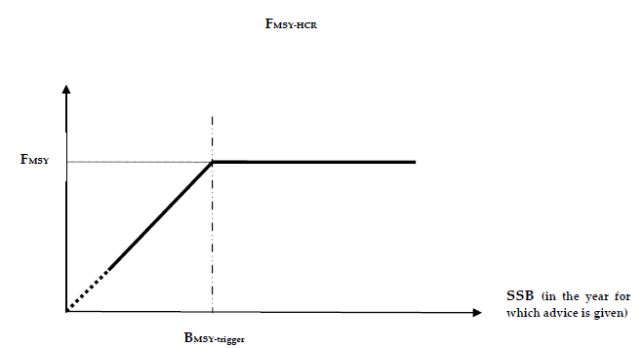
ICES Fmsy Framework Long or medium lived species
MSY policy

Slide 9
Recent state of catches – if not biomass estimates available
Status of exploitation relative to Fmsy – overfishing or no overfishing and stock trend

Slide 10
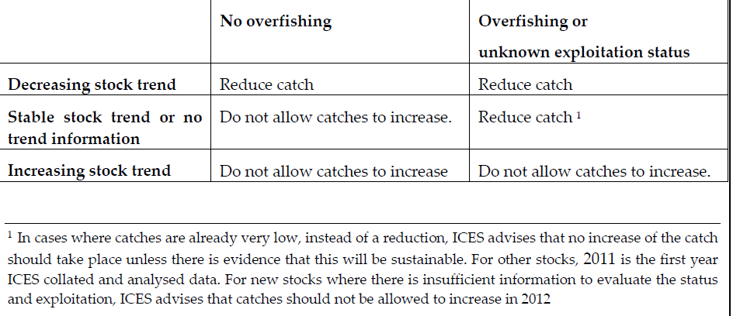
Data limited stocks
Abundance of species from trawl surveys
Age and size
Or…. No data! Then..?????

Slide 11
Do not act mechanically!

Slide 14
F_{msy} as a LRP
F<Fmsy – economically viable;
SSR – unidentified in most cases;
Fmax is very high value (not to be used as a proxy of Fmsy);
F_{msy} to M (e.g.F/Z ≈ 0.5),
Fmsy Dependant on exploitation models – fishing mortality per age;
Change of selectivity of fishing gears or exploitation - change of Fmsy
Z from surveys – Zmbp <Zmsy (Maximum biological Production)

Slide 15
Opinions
Pilling et al. (2008) – MSY RP are not fully objective due to variability of biological processes
Kell & Fromentin (2007) – changing fishery regimes (e.g.selectivity)
Mace (2001) - Fmsy – LRP,
Jennings (2005) - EU Fishery Agency – Benefits for the society if the managers reach TRP but not to avoid LRP
Without RPs -not in accordance with Precautionary Approach, Rio declaration, 1992) and UNCLOS,1982

Slide 16
Precautionary approach
Management procedures in force and consequences from application;
Range of applicable management actions;
Structure of the stocks, subject to management;
Basic “predator-prey” relationships;
Main influences of the environment on the recruitment and growth of stock;
Stocks distribution according to the fisheries;
Spawning areas;
Nursery areas;
Migration routs of size-age groups;
Impact of density on the growth/distribution;
Recruitment variability;
SSR relationship;
Fishing fleet composition, relations and selectivity of the fishing gears;
Pros and accuracy of different approaches for stock assessment;
Stock decline (collapse) possibility (e.g. what was happened in the past periods/ stocks with similar characteristics)

