Slide 1



Marine Strategy: a guideline for the development of operational oceanography
Giordano Giorgi*, Cecilia Silvestri*, Francesco Lalli*, Antonello Bruschi*, Valeria Pesarino*, Maria Luisa Cassese*, Erika Magaletti*, Franco Giovanardi*, Francesco Rende * Sasa Raicevich*
*ISPRA (Institute for Environmental Protection and Research) – Rome-Italy
GNOO- Oristano, 3-5 Giugno 2013 - CNR

Slide 2
On July 15, 2008
came into force the Marine Strategy Framework Directive (Directive 2008/56/EC)
The main objective:
to achieve or maintain good environmental status in the marine environment by the year 2020.
Good environmental status:
the environmental status of marine waters, considering the structure, functions and processes of the constituent marine ecosystems together with the associated physiographic, geographic and climatic factors, hydro-morphological, physical and chemical properties, including those resulting from human activities in the area concerned. The use of the marine environment is at level that is sustainable.
GNOO- Oristano, 3-5 Giugno 2013 - CNR

Slide 3
Spatial scale of the Directive
WFD
MSFD
GNOO- Oristano, 3-5 Giugno 2013 - CNR

Slide 4
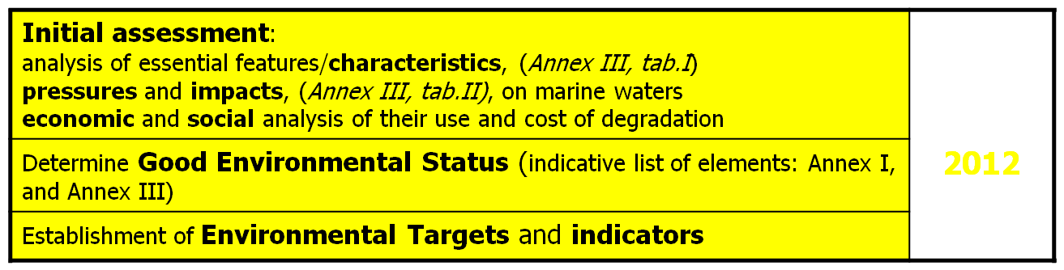

Steps for National Marine Strategies development
2012
Building upon existing activities developed within EU Directives and Regional Sea Conventions
2020
To achieve or maintain Good Environmental Status in the marine environment
Adaptive management , with regular review (every 6 years)
GNOO- Oristano, 3-5 Giugno 2013 - CNR

Slide 5
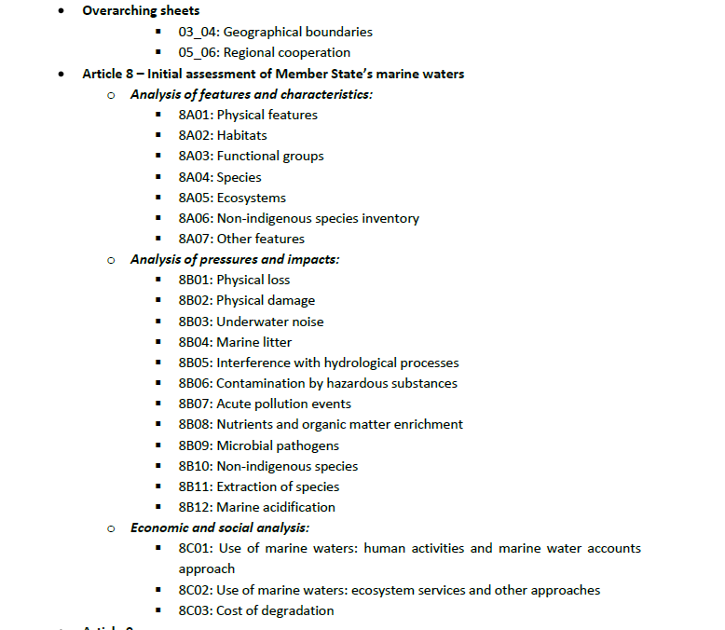
The initial assessment of marine waters through the existing data
Data currently available
GNOO- Oristano, 3-5 Giugno 2013 - CNR

Slide 6
RS- Physical features
Parameters
Data/information used
Topography Bathymetry Surveys
Sea Surface Temperature Satellite data
SeaBottom Temperature Oceanographic campaigns
                MyOcean’s numerical model
Turbidity Oceanographic campaigns
Upwelling RMN and satellite data
Mixing characteristics MyOcean’s numerical model
Salinity MyOcean’s numerical model
Current velocity MyOcean’s numerical model
Wave Exposure ECMWF numerical model
ResidenceTime MyOcean’s data post processing lagrangian particle model
GNOO- Oristano, 3-5 Giugno 2013 - CNR

Slide 7
RS- Interference with hydrological process
Report WISE RBMP data on analysis of pressures and impacts of coastal water bodies due to saline and temperature changing regime
RS- Nutrient and organic matter enrichment
RS- Descriptor 5: Eutrophication
Parameters
Data/information used
Nutrients In situ monitoring data
                MyOcean’ s numerical model
                LTER-MC database
                VECTOR-NASA database
Oxygen In situ monitoring data
Chlorophyll a In situ monitoring data Satellite data
phytoplankton In situ monitoring data
GNOO- Oristano, 3-5 Giugno 2013 - CNR

Slide 8
Determination of Good Environmental Status GES
D1-Biodiversity
14 Indicators
D2-Non idegenous species
3 Indicators
D3-Fisheries
7 Indicators
D4-Food web
3 Indicators
D5-Eutrophication
56
8 Indicators
D6-Seafloor integrity
6 Indicators
D7-Hydrgrafic condition
3 Indicators
D8-Contaminants
3 Indicators
D9-Contaminants in seafood
2 Indicators
D10-Litter
4 Indicators
D11-Noise
2 Indicators
GNOO- Oristano, 3-5 Giugno 2013 - CNR

Slide 9
Art 8a: Characteristics | Art 8b: Pressures & impacts | Art. 9 GES
C1: Physical features C2: Chemical features C3: Habitats C4: Functional groups C5: Species C6: Ecosystems C7: Other features | P1: Physical loss P2: Physical damage P3: Underwater noise P4: Marine litter P5: Hydrology P6: Contaminants P7: Nutrient and organic matter enrichment P8: Microbial pathogens P9: Non-indigenous spp P10: Selective extraction | D1 Biodiversity D2 Non-Indigenous species D3 Fisheries D4 Food webs D5 Eutrophication D6 Seafloor integrity D7 Hydrographic conditions D8 Contaminants D9 Contaminants in seafood D10 Litter D11 Underwater noise
GNOO- Oristano, 3-5 Giugno 2013 - CNR

Slide 10
Report MSFD
Initial assessment
Determination of GES
Establishment of environmental target
Paper report
General context, methodologies,
Executive summary
Reporting sheets
Analytical information (data)
Supporting documents
Cartography, detailed information, bibliography etc.
Italy
October 2012
April 2013
QA/QC
European Environmental Agency
REPORTNET
European Commission
WISE Marine
GNOO- Oristano, 3-5 Giugno 2013 - CNR

Slide 11
La Direttiva Quadro sulla Strategia per l’Ambiente Marino
TIMING
According to the MSFD management cycle, at the moment all Member States completed both the Initial assessment and the Determination of their GES .
Now the EC is assessing all reports and already a high variability of approaches is resulted.
The lack of specific methodologies and/or technical guidelines regarding some descriptors and related indicators limits an EU-wide harmonisation
2012
Initial assessemnt, determination of GES, establishment of target
G
F
M
A
M
G
L
A
S
O
N
D
1° Reporting to EC
2013
2° Reporting to EC
G
F
M
A
M
G
L
A
S
O
N
D
2014
Monitoring programmes
G
F
M
A
M
G
L
A
S
O
N
D
2015
Elaboration of programmes of measures
G
F
M
A
M
G
L
A
S
O
N
D
2016
Start up of
Programmes of measures
G
F
M
A
M
G
L
L
A
S
O
N
D
GNOO- Oristano, 3-5 Giugno 2013 - CNR

Slide 12




Which scientific gaps have been highlighted by the initial assessment?
Identification of geographical and functional limits (range of variability) of ecosystems
Assessment of the cumulative impacts of human pressures on benthic, pelagic habitat integrity as well as ecosystem functioning and their effects on biodiversity
Impacts on benthic and pelagic communities due to alteration of hydrological characteristics
Physiographic features and consequences for food-web structure and functional ecosystem processes
GNOO- Oristano, 3-5 Giugno 2013 - CNR

Slide 13
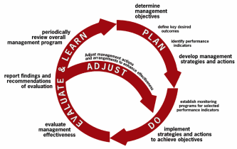
MSFD – Ecosystem approach and Adaptive management
with regular review (every 6 years)
The ecosystem approach requires adaptive management to deal with the complex and dynamic nature of ecosystems and the absence of complete knowledge or understanding of their functioning….
Management must be adaptive in order to be able to respond to such uncertinties and contain elements of “learning-by-doing” or research feedback.
Measures may need to be taken even when some cause-and-effect relationships are not yet fully established scientifically
GNOO- Oristano, 3-5 Giugno 2013 - CNR

Slide 14
Some gaps could be compensed during the following MSFD cycle (ending in 2018) by developing new methods and gathering additional data
GNOO- Oristano, 3-5 Giugno 2013 - CNR

Slide 15
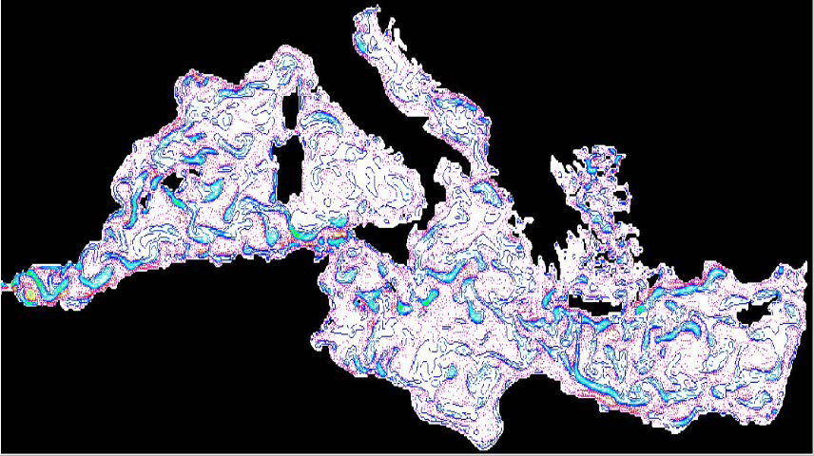
Is t possible to reduce these scientific gaps?
YES………advancing a methodological framework in order to provide guidelines for developing operational oceanography
GNOO- Oristano, 3-5 Giugno 2013 - CNR

Slide 16
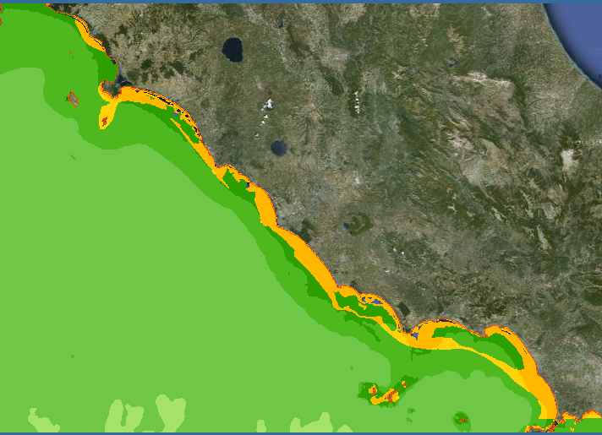
HOW?
1) Defining the geographical and functional limits (range of variability) of ecosystems using oceanographic data from models, and other more variables
GNOO- Oristano, 3-5 Giugno 2013 - CNR

Slide 17
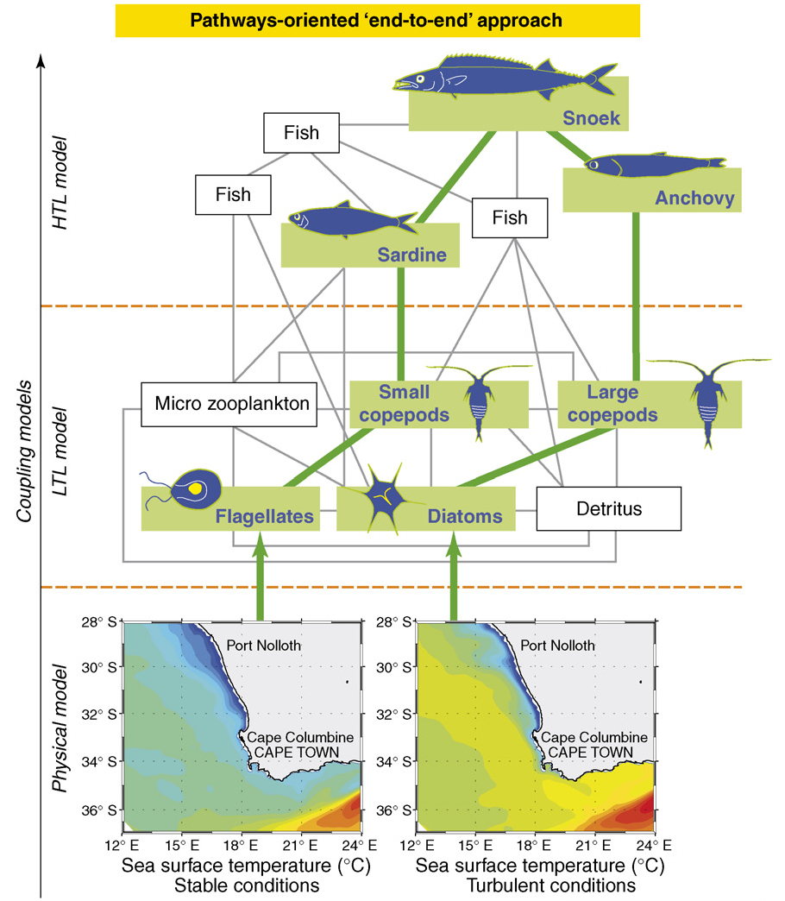
and
2. Setting up a modelling framework for assessing the relationships between natural (such as meterological, hydrodynamical, morphological ) and human pressures (mainly eutrophication, pollution, dredging, trawiling) and the benthic and pelagic physical and ecological characteristics
GNOO- Oristano, 3-5 Giugno 2013 - CNR

Slide 18
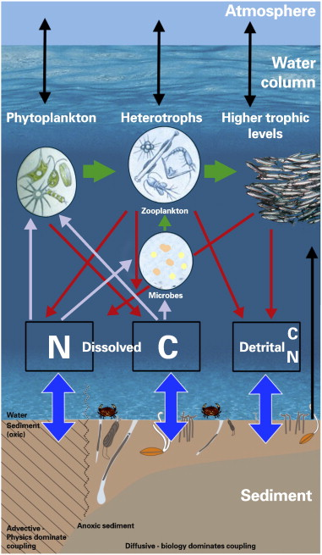
Main step to do that…………?
Characterise forcing processes
Describing the generic and specific hydrological, sedimentary and biological forcing processes involved in selected areas for the pelagic and benthic environment, how human pressures affect such processes and formalising these relationships (knowledge rules) in a generic framework for modelling
GNOO- Oristano, 3-5 Giugno 2013 - CNR

Slide 19
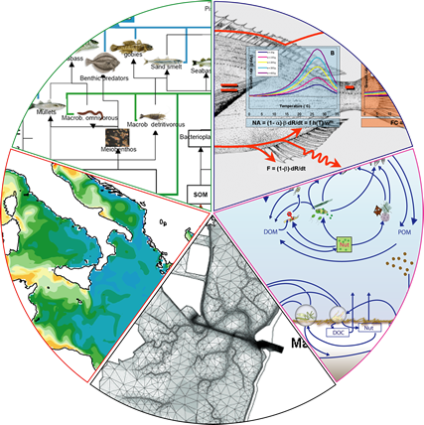
Set up a modelling framework
Select the available models for simulating the state and dynamics of the benthic and pelagic, physical and ecological processes and how natural and antropogenic pressures in general relate to the various parameters and modules in the model.
Developing sets of submodels to be intercompared: physical forcing models, biogeochemical models, and ecological models
Set up an end-to-end modelling framework, integrating above mentioned modules.
GNOO- Oristano, 3-5 Giugno 2013 - CNR

Slide 20
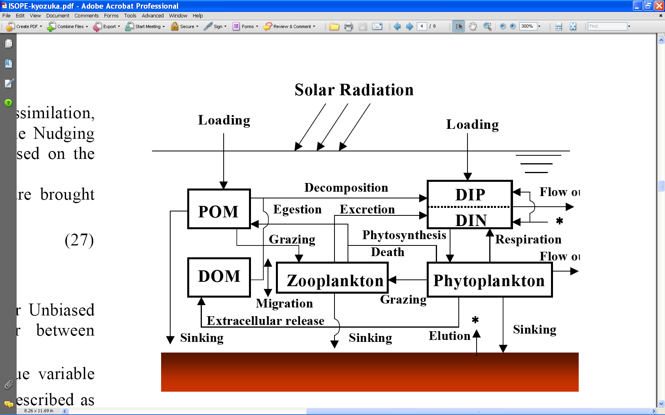
Pelagic model
Pelagic ecology must be described by grouping higher trophic level organism in functional groups, or focusing on target species, by following carbon dynamics and energy flows and by deriving synthetic indicators of ecosystem structure and functioning
GNOO- Oristano, 3-5 Giugno 2013 - CNR

Slide 21
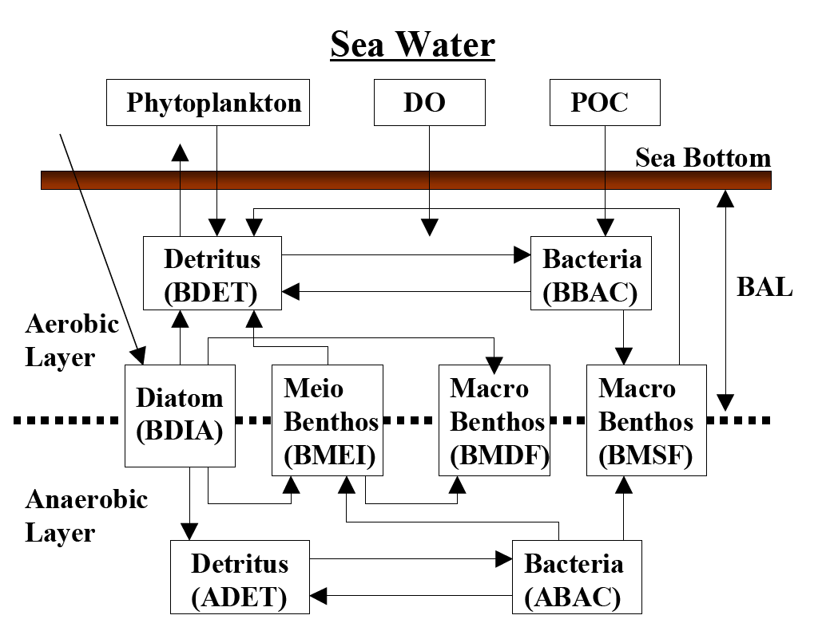
Benthic model
Benthic ecology must be simulated up to species functional groups (diversity, size distributions, tolerant/sensitivespecies groups, etc..) habitat heterogeneity (gamma diversity, i.e assemblages in landscapes, small scale to mesoscale morphological features), and ecosystem fubctionality (functional traits, organic carbon processsing, relationships with demersal fish production
GNOO- Oristano, 3-5 Giugno 2013 - CNR

Slide 22
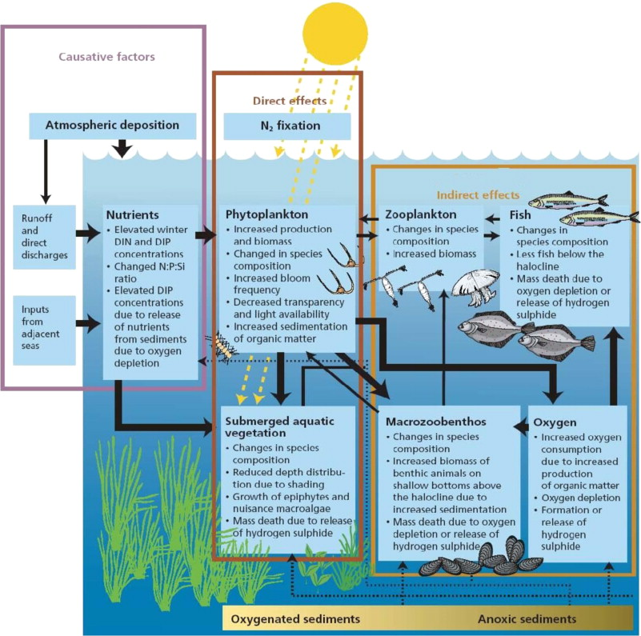
End-to-End model
Integration a coupled benthic pelagic biogeochimical model and a marine food web model
GNOO- Oristano, 3-5 Giugno 2013 - CNR

Slide 23
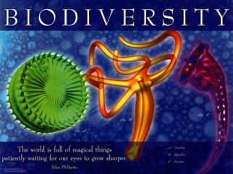
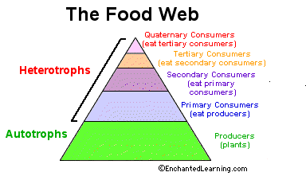
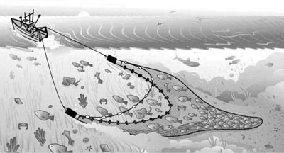

Testing and validation of indicators for:
D1 (Biodiversity)
D4 (Food webs)
D5 (Eutrophication)
D6 (Seafloor integrity)
D7 (Hydrological alteration)
Selecting indicators for the three levels (species, habitat and ecosystem functioning) among those chosen in the determination of GES and formalising them within the three modules:
Dose-effect relationships for each pressure and indicator combination
Calibration runs for reliability and sensitivity analyses to test indicator performance
Indicator validation in the subregional seas for multiple/cumulative pressures
GNOO- Oristano, 3-5 Giugno 2013 - CNR

Slide 24
How to reduce the gap about the impacts on benthic and pelagic communities due to alteration of hydrological characteristics?
Description of the quantitative level of pressure due to change of the thermal regime or salinity using parameters: volume, flow, dispersion.
The tools for this study are models of hydrodynamics and coastal oceanography (MyOcean) and monitoring.
2) Description of the quantitative level of impact due to changes in the thermal regime and salinity through the study of the alteration of community (eg species composition) and ecosystem functions.
Possible tools: modeling, mapping of benthic habitats (EuSeaMap) and monitoring.
GNOO- Oristano, 3-5 Giugno 2013 - CNR

Slide 25

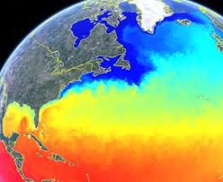
Development of innovative monitoring systems
Integrating the information from tested and validated indicators and developed modelling tools to develop innovative monitoring approach, that efficiently and effectively assess the effects of human activities on marine environment in space and time, providing data/advices useful to achieve or maintain “good environmental status”.
These monitoring systems could support ongoing monitoring programs of Member States that shall be implemented by 2014 according to Article 5 and 11 of MSFD.
GNOO- Oristano, 3-5 Giugno 2013 - CNR

Slide 26

GNOO- Oristano, 3-5 Giugno 2013 - CNR

